Slide 1
MICROSOFT MOVIE STUDIO
MARCH [2023]
PRESENTATION BY
DENNIS MWANZIA
NEW STUDIO

Slide 2
Analyzed: runtime, budget, genre, TMDB average vote
score, profit, and ROI.
● Best ROI:
○ Short time (< 90 minutes)
○ Low budget (<16 millions)
○ Genre: Horror or Thriller
● Best Profit and Review
○ Long time (> 132 Minutes)
○ High budget (>58 millions)
○ Genre: Action, Adventure, Sci-Fi or Thriller

Slide 3
Outline
● Business Problem
● Data
● Methods
● Results
● Conclusions

Slide 4
Business Problem
Microsoft wants to create a new movie studio.
● What type of movies are currently doing the best?
● Microsoft’s brand is valuable.
● Generate actionable insights!

Slide 5
Data
● Data Source:
○ Box Office Mojo
○ IMDB
○ TheMovieDB.org
● Dependent Variables to optimize:
○ ROI = profit / budget
○ Average vote
○ We’ll also talk about absolute
profit
● Independent Variables which
influence ROI and average vote:
○ Runtime
○ Budget
○ Genre
○ Studio

Slide 6
Methods
● Joined data from many sources
● Analyzed 1000+ movies
● Plotted and computed regression lines comparing 1 independent and
dependent variable at a time
● Iteratively improved expected ROI by fixing best options for dependent
variables
● Stopped when sample size became too small to remain meaningful

Slide 7

Results

Slide 8
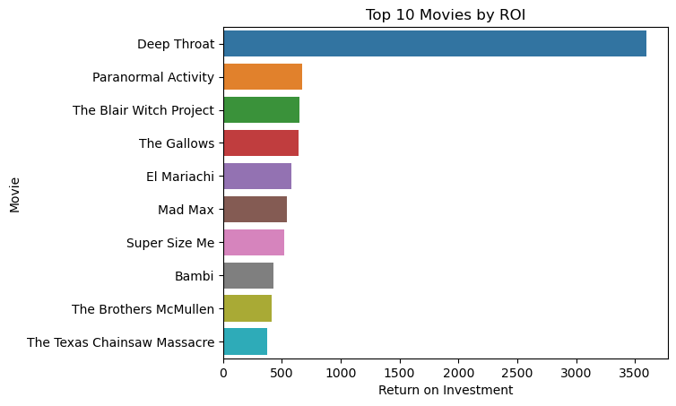
Top 10 Movies by ROI

Slide 9
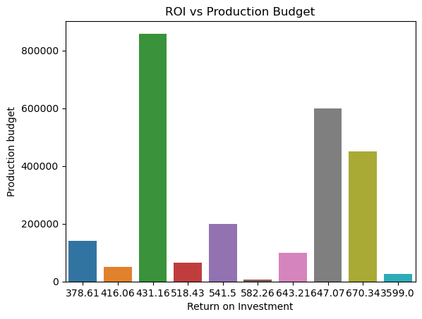
ROI vs Production budget

Slide 10
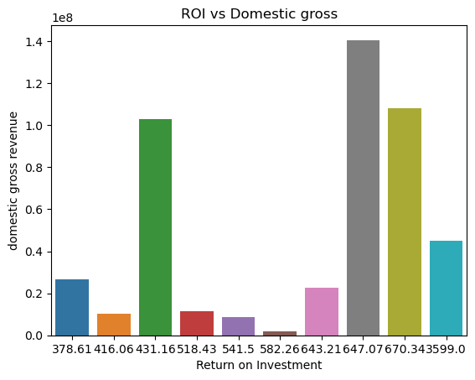

Slide 11
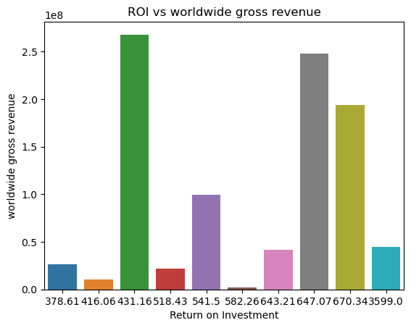

Slide 12
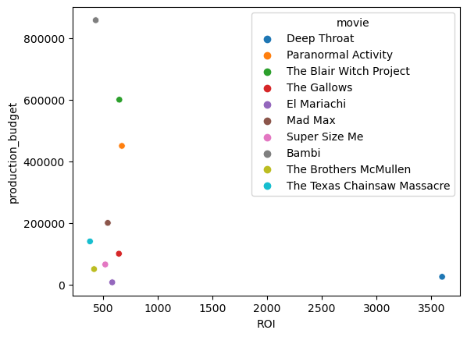

Slide 13
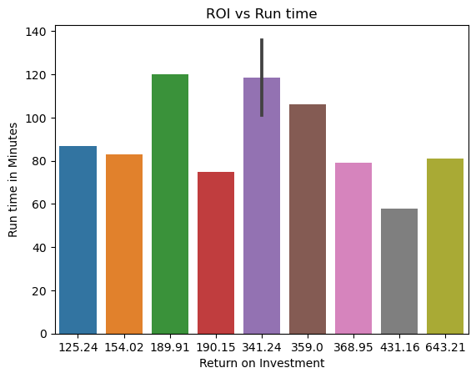

Slide 14
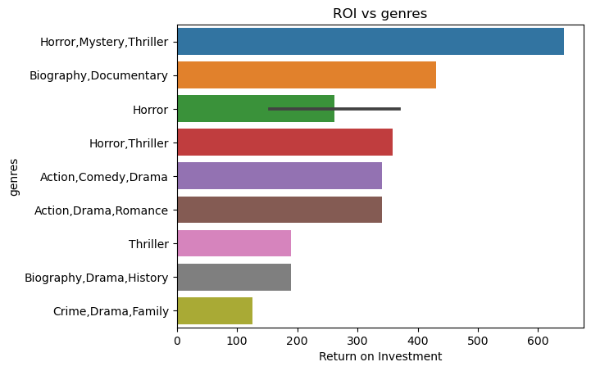

Slide 15
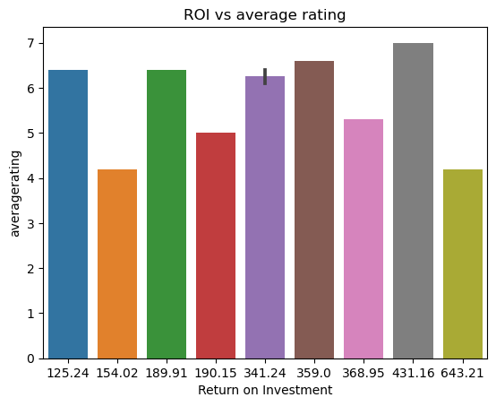

Slide 16
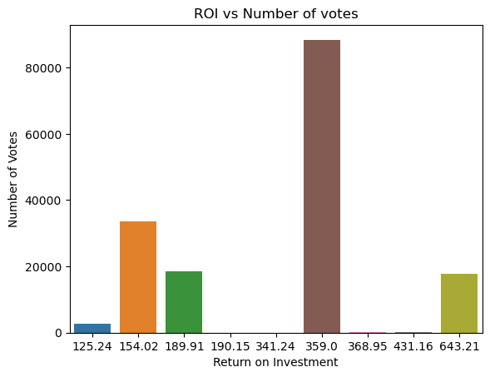

Slide 17
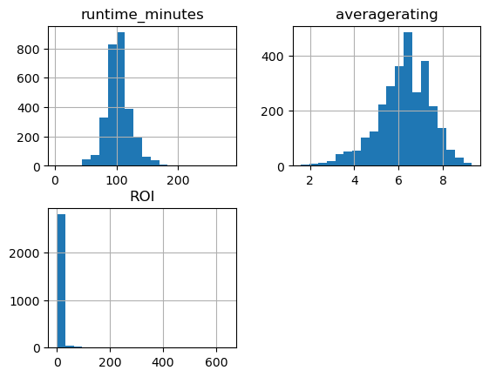
Visualize the distribution of runtime, ratings, and ROI using histograms
Notes:
Runtime and average rating distributions are normal

Slide 18
Correlation between variables
 | runtime_minutes | averagerating | ROI
runtime_minutes | 1.000000 | 0.203768 | -0.028707
averagerating | 0.203768 | 1.000000 | 0.007536
ROI | -0.028707 | 0.007536 | 1.000000

Slide 19
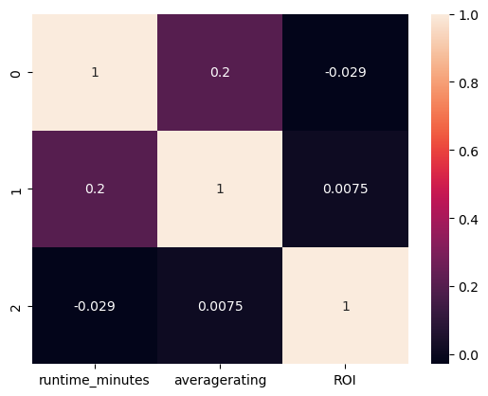
The darker shades indicate higher correlation values, while the lighter shades indicate lower correlation values
Notes:
From this heatmap, we can see that there is a weak positive correlation between runtime_minutes and averagerating, and a weak negative correlation between runtime_minutes and ROI. There is also a very weak positive correlation between averagerating and ROI.

Slide 20
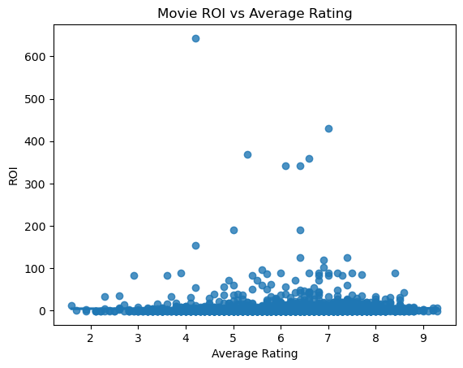
No strong correlation between average rating and ROI
Notes:
we can see that there is no strong correlation between average rating and ROI. There are some movies with high ROI and high average rating, but there are also some movies with low ROI and high average rating, as well as movies with high ROI and low average rating.

Slide 21
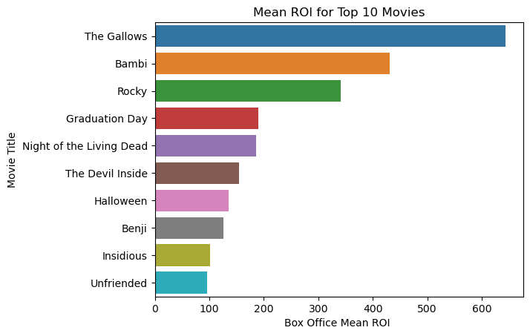
The Gallows" has the highest earnings by far, followed by "Bambi" and "Rocky".

Slide 22
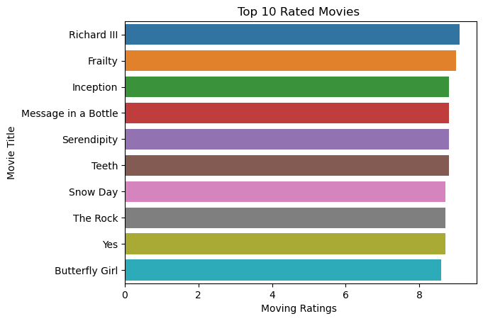

Slide 23
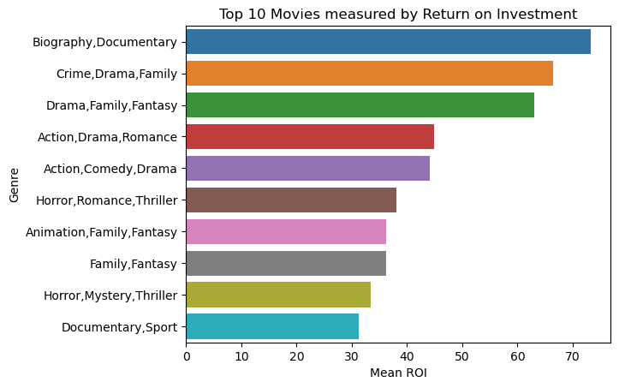

Slide 24
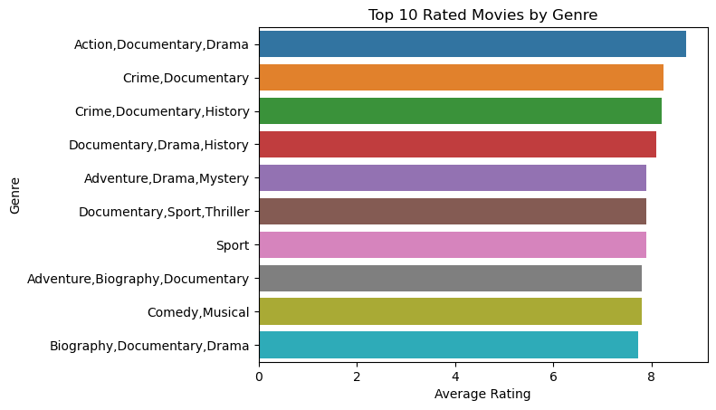

Slide 25
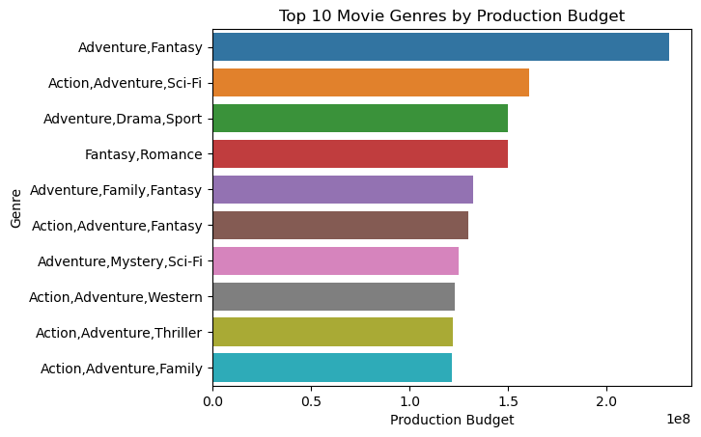

Slide 26
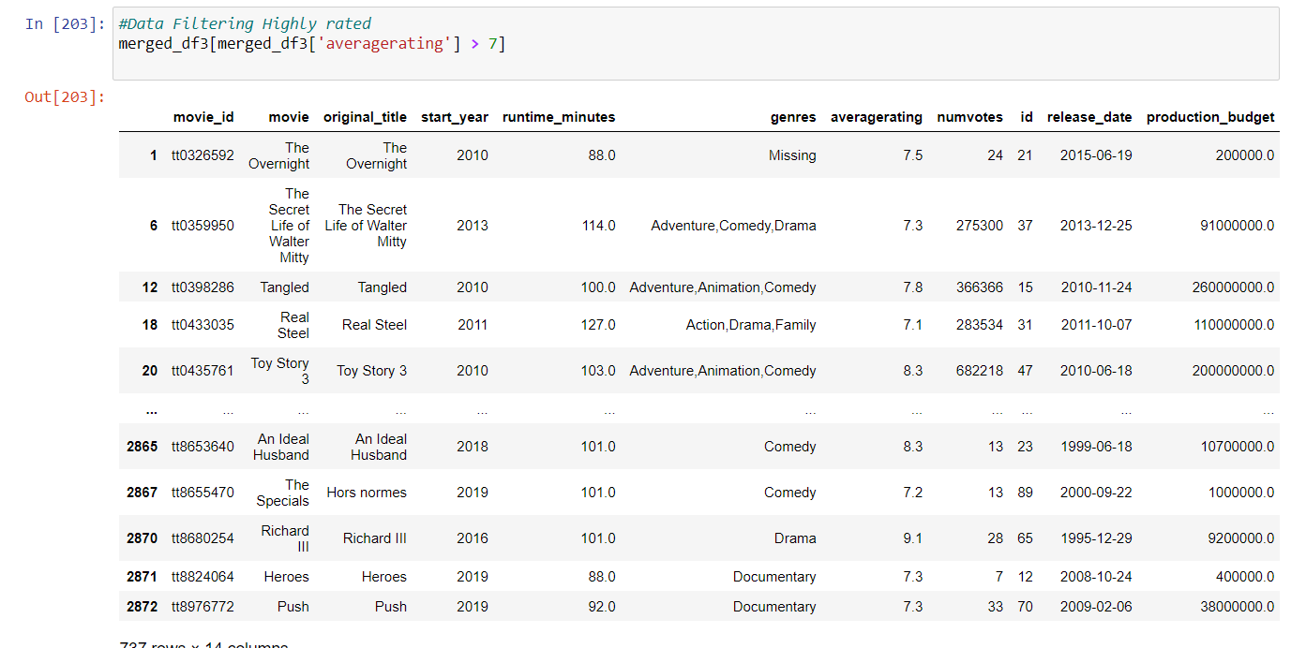

Slide 27
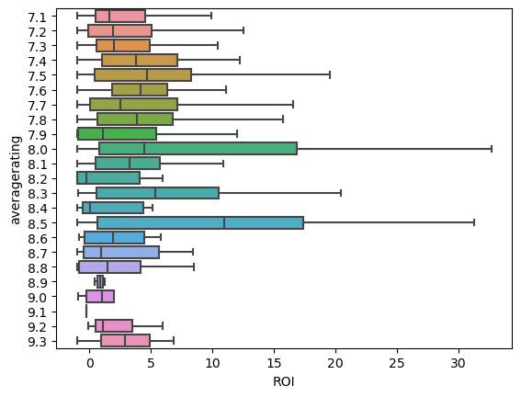
Highly Rated Movies Box Plot

Slide 28
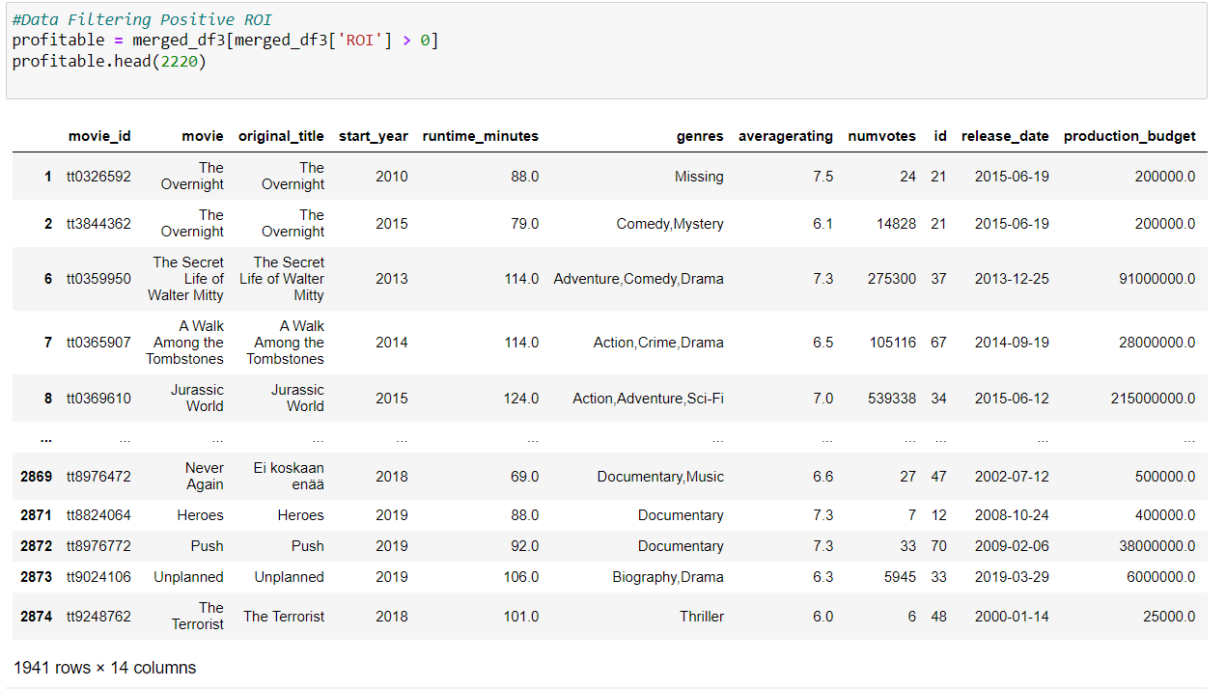

Slide 29
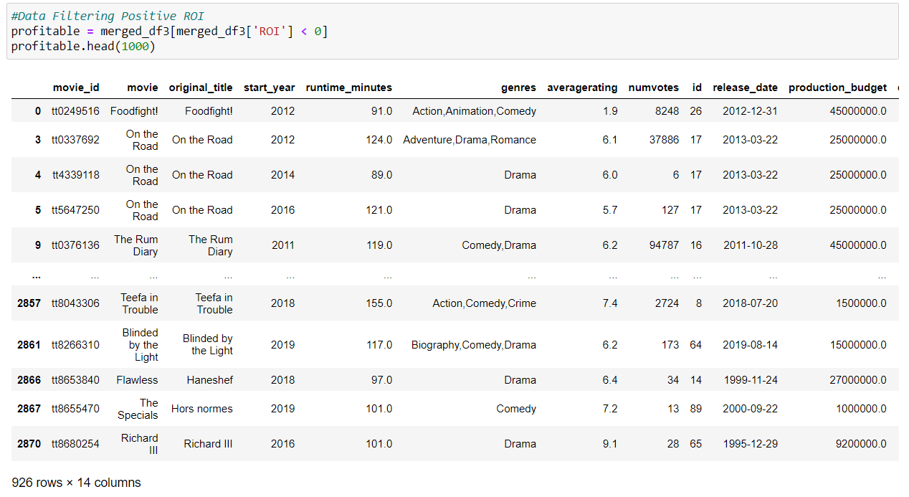

Slide 30
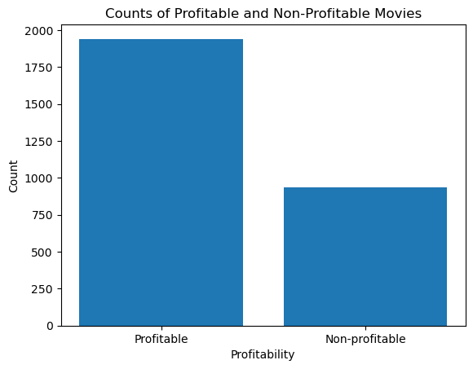
Profitable & Non-Profitable Movies

Slide 31
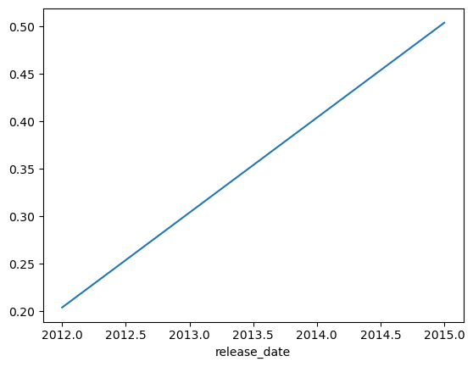
Movie Average Rating Over time

Slide 32
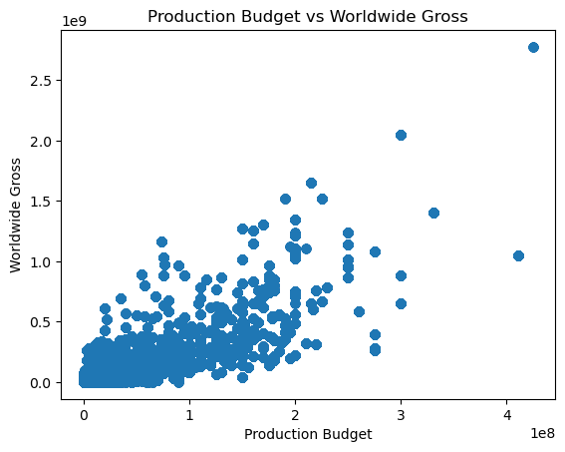
Production Budget vs Worldwide Gross

Slide 33
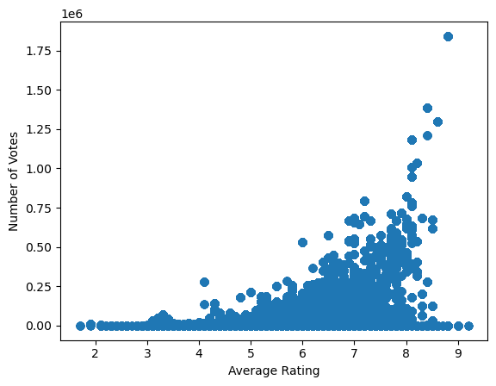
Correlation coefficient between numvotes and averagerating: 0.5124943038145994

Slide 34
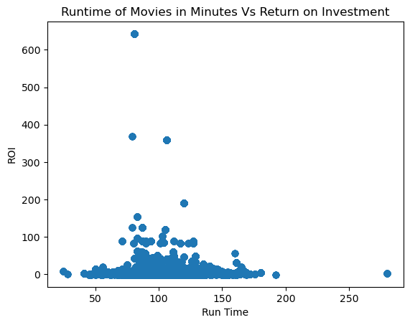

Slide 35
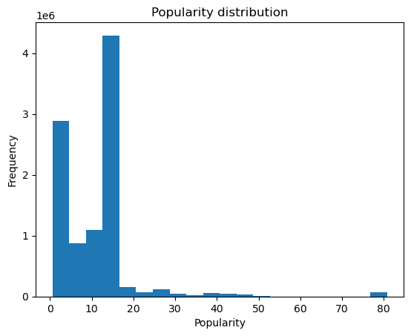

Slide 36
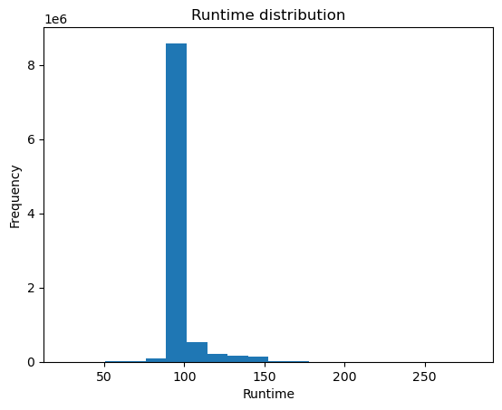

Slide 37
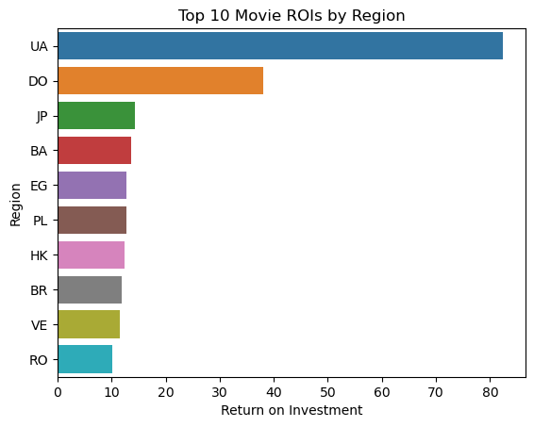

Slide 38
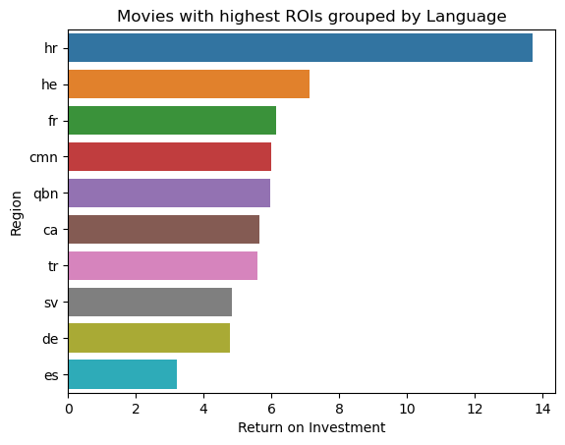

Slide 39
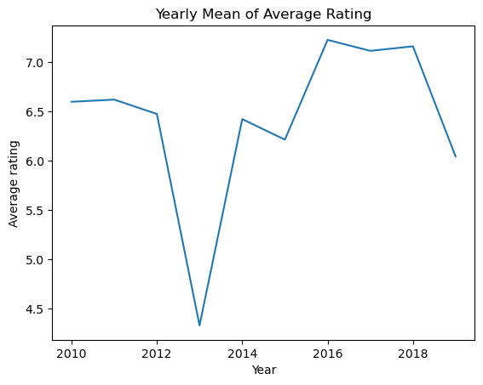

Slide 40
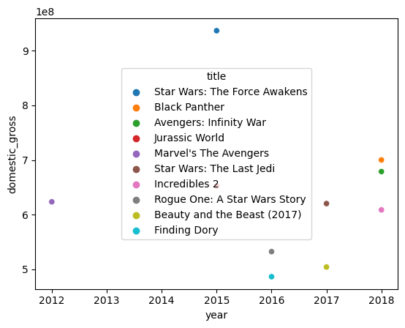

Slide 41
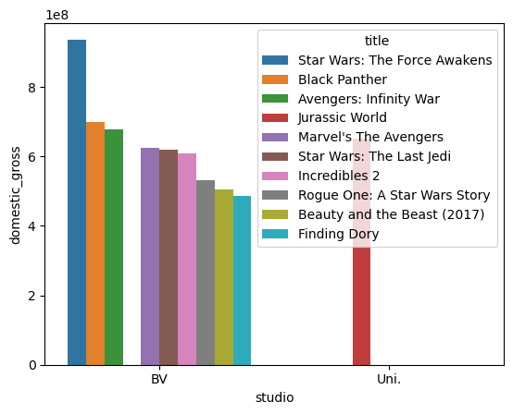

Slide 42
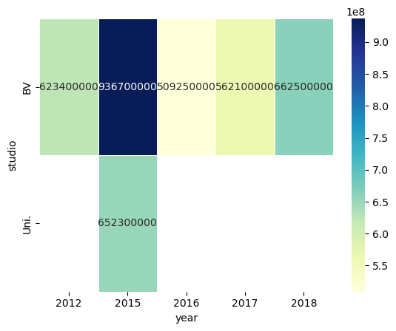

Slide 43
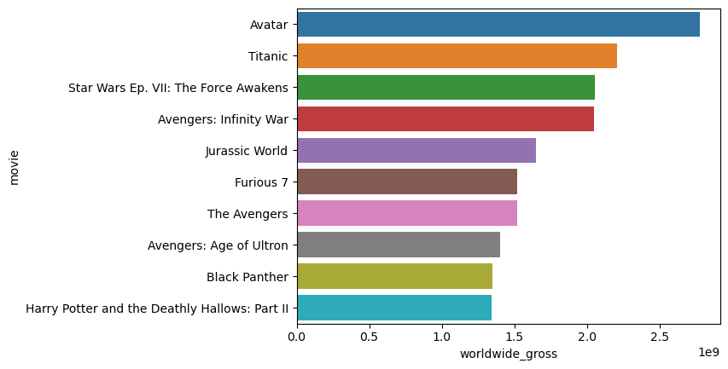

Slide 44
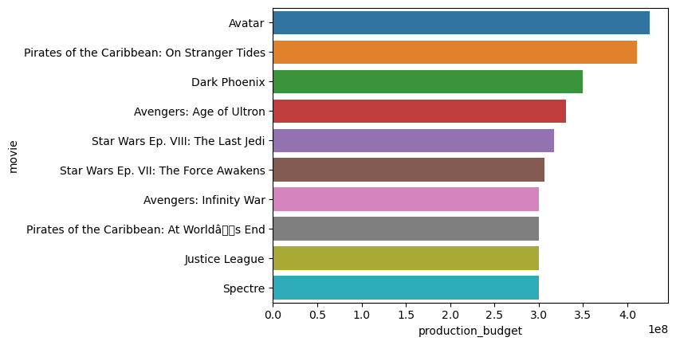

Slide 45
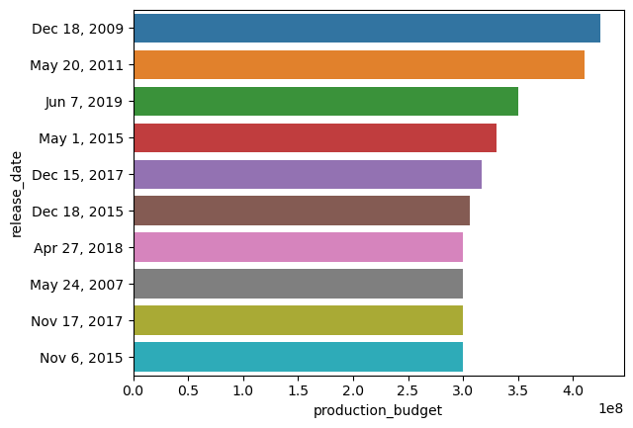

Slide 46
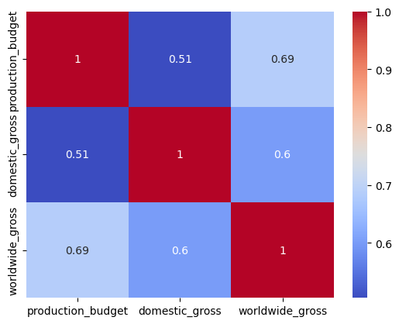
Notes:
A heat map to visualize the relationship between the production budget, domestic gross, and worldwide gross of the top 10 movies. Different colors to represent the values and plot the movies on the y-axis and the different variables on the x-axis.

Slide 47
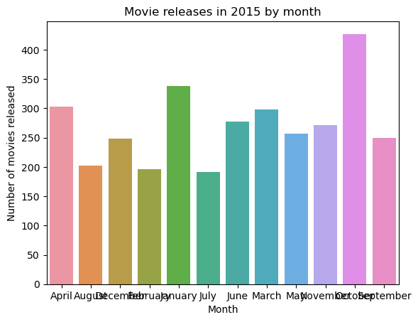

Slide 48
Conclusions
● “Middle of the Road” movies are the worst across all metrics:
○ Make a low-budget (for best ROI) or high budget (for best profit, best ratings,
good ROI) movie, not a middle budget movie
○ Make a movie that is either long or short, not medium length
● Pick Genre that suits budget and length:
○ Horror, Thriller for Low Budget Short Movies
○ Action, Adventure, Sci-Fi, Thriller for High Budget Long Movies
● Intellectual Property seems important for successful High Budget Long Movies
○ Buy movie rights for comic book superheroes or popular books.
● Further Research
○ We can help analyze directors, writers, actors within a certain genre, budget,
runtime once you make a decision!

Slide 49

Thank you
Email : dennomwanzia@gmail.com
Github: https://github.com/DennisMwanzia
LinkedIn: https://www.linkedin.com/in/dennis-mwanzia-271412232/

Slide 50
MOVIE Fun
MARCH [2023]
THANK YOU
MICROSOFT NEW MOVIE STUDIO

